Slide 1
Microsoft.Graph.PlusPlus
WHO , WHERE, WHAT, WHY and HOW ?
James O’Neill

Slide 2
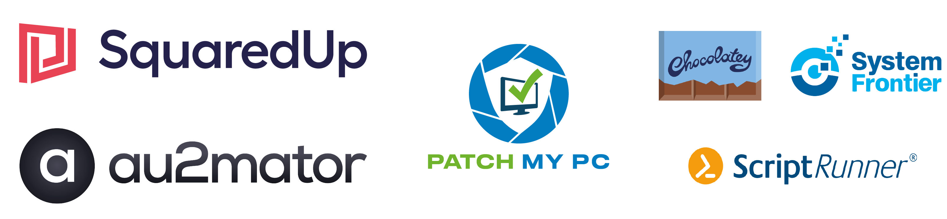
Many thanks to our sponsors:

Slide 3

James O’Neill
PowerShell veteran since 2007
Avatar from www.sp-studio.de is almost as old
J@mobulaConsulting.com
Twitter: @JamesOneill
github: jhoneill
Blog https://jhoneill.github.io/

Slide 4
Where do I get it ?
Source: https://github.com/jhoneill/MsftGraph
Module: search “plusplus” on the PowerShell gallery

Slide 5
What’s graph ?
A common entry point for REST APIs to drive Office 365 and Azure-AD (not the whole of Azure)

Slide 6
What is Graph ++
There are already “SDK” modules for Graph
PlusPlus adds usability and “PowerShelliness”
It works with SDK modules & returns the same objects
Pure SDK scripts and PlusPlus scripts will interoperate
PlusPlus needs DLLs from the SDK modules (and skips loading some parts if they are not found).
Has extra logon methods (helps non-interactive use)

Slide 7
Why ?
SDK is auto generated from the Rest API definitions:
PUT https://graph.microsoft.com/v1.0/users/{Userid}/manager/$ref { "@odata.id": "https://graph.microsoft.com/v1.0/users/{managerid}" }
Becomes Set-MgUserManger –UserId xxx –ManagerID yyyy
Don’t do things PowerShell should do
WhatIf, pipeline Input, tab-expansion, find-by-name
And they fragment commands; shouldn’t this be Set-user –Manager yyyy –Department zzzz
Notes:
Why isn’t the SDK PowerShelly

Slide 8
API call ≠ command
User: “I want to Create / Read / Update / Delete widgets”
Expect human-readable output & a helpful UI (e.g. confirm deletions)
Module: “I provide a UI & call the API”
It adds intelligence between the two
>80% of work is <20% of API, quality beats completeness
PowerShell handles http calls, JSON translation, formatting etc.
API: “I do what Programs tell me”
Won’t question delete requests, speaks in JSON (or similar)
The job isn’t moving API entry points from http calls to typing
Notes:
Code sits in an interface sandwich.

Slide 9
How does it work ?
On load: import DLLs from SDK modules (authentication is required) & load the script(s) each DLL enables.
Connect: wrap Connect-MgGraph from the SDK (optionally, get an access token for Connect-MgGraph)
Pattern for PowerShelly functions:
Confirm connection exists and is the right type for the task
Make call(s) to Invoke-MgGraphRequest from the SDK
Transform JSON returned into SDK objects (hence the DLLs)
Use Type & Format XML to extend/display these

Slide 10
How do we use it ? What does it look like ?
A.k.a Demo time
Warning: Some errors are shown intentionally
Others may occur spontaneously.

Slide 11
Demos
We love Demos!

Slide 12
Q&A
15 minutes

